Slide 1





MALTAomics Summer School
Introduction to Genomic Data Science
Panagiotis Alexiou
ERA Chair,
Bioinformatics for Genomics in Malta
(BioGeMT)

Slide 2
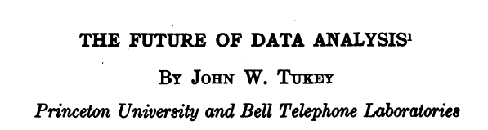
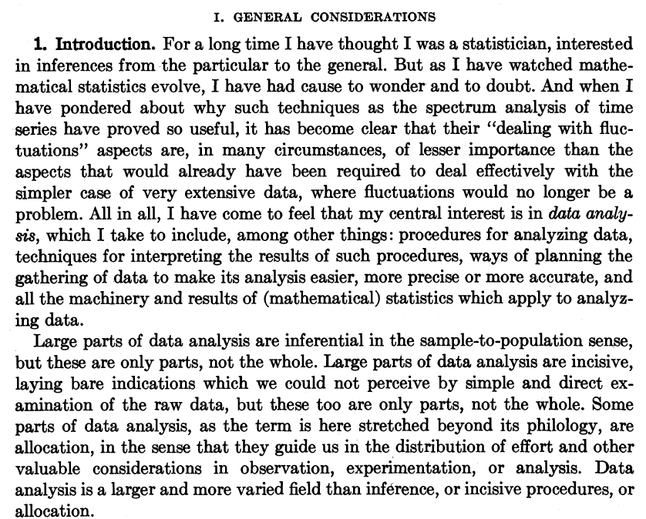
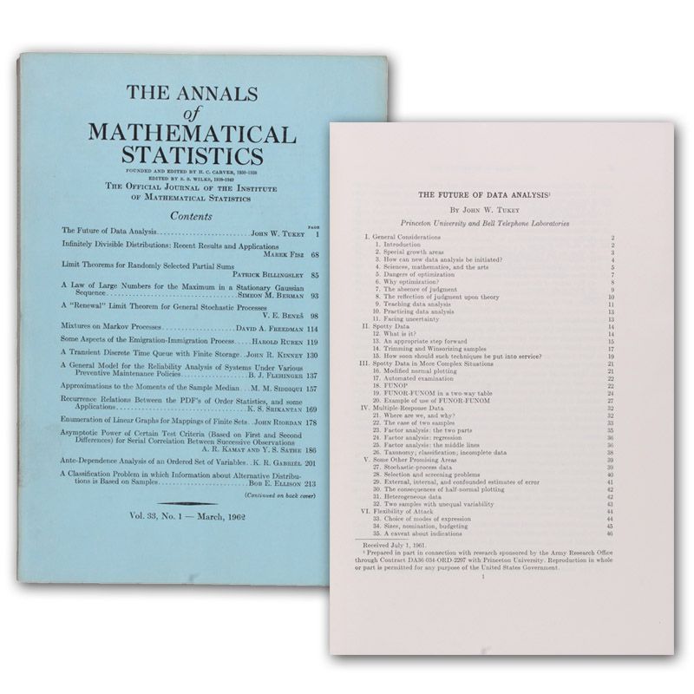
1962
https://projecteuclid.org/journals/annals-of-mathematical-statistics/volume-33/issue-1/The-Future-of-Data-Analysis/10.1214/aoms/1177704711.full

Slide 3
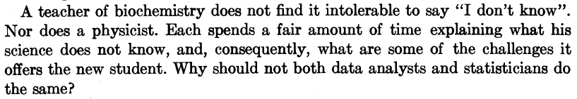
1962
https://projecteuclid.org/journals/annals-of-mathematical-statistics/volume-33/issue-1/The-Future-of-Data-Analysis/10.1214/aoms/1177704711.full

Slide 4

Data Science is an interdisciplinary academic field that uses statistics, scientific computing, scientific methods, processes, algorithms and systems to extract or extrapolate knowledge and insights from noisy, structured, and unstructured data.

Slide 5
Exploring the Intersection of two Revolutionary Fields
Data Science is an interdisciplinary academic field that uses statistics, scientific computing, scientific methods, processes, algorithms and systems to extract or extrapolate knowledge and insights from noisy, structured, and unstructured data.
Genomics emerged in the 1980s as the confluence of genetics, statistics, and large-scale datasets. This pre-eminent role of genomics also inspired the emergence of many “-omics” terms inside and outside academia.
Genomics

Slide 6
Exploring the Intersection of two Revolutionary Fields
Data Science is an interdisciplinary academic field that uses statistics, scientific computing, scientific methods, processes, algorithms and systems to extract or extrapolate knowledge and insights from noisy, structured, and unstructured data.
Genomics Data Science is an interdisciplinary academic field that uses statistics, scientific computing, scientific methods, processes, algorithms and systems to extract or extrapolate knowledge and insights from noisy, structured, and unstructured genomic data.
Genomics emerged in the 1980s as the confluence of genetics, statistics, and large-scale datasets. This pre-eminent role of genomics also inspired the emergence of many “-omics” terms inside and outside academia.
Genomics

Slide 7
Exploring the Intersection of many (?) Revolutionary Fields
-omics Data Science is an interdisciplinary academic field that uses statistics, scientific computing, scientific methods, processes, algorithms and systems to extract or extrapolate knowledge and insights from noisy, structured, and unstructured -omic data.
Genomics
Transcriptomics
Proteomics
Metabolomics
Epi-(omics)
Phenomics
…
-omics
-omics
Methods common in the analysis of various –omics data and their combination (multi-omics)

Slide 8
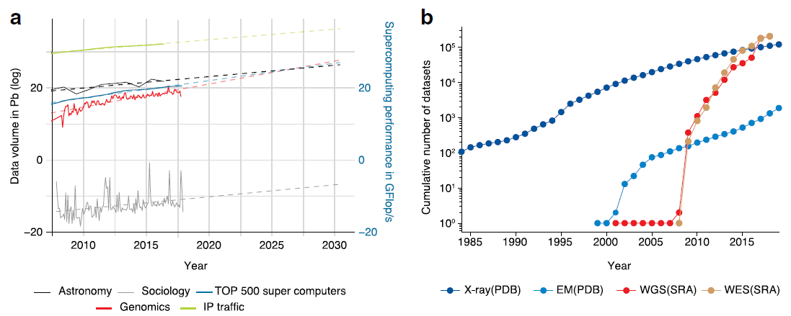
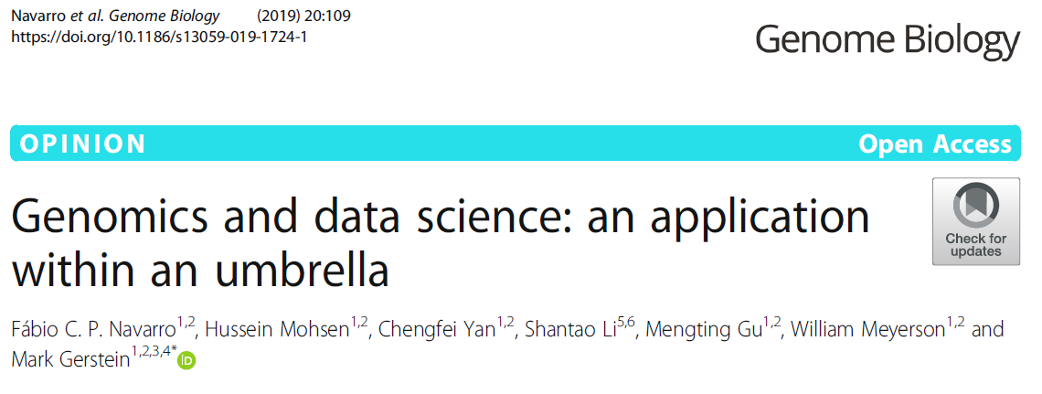
V framework of Data
Volume
Velocity
Variety

Slide 9
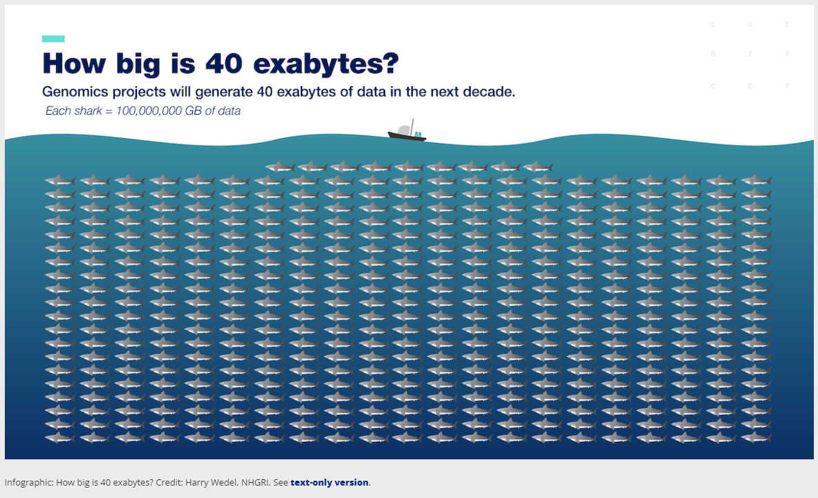

Slide 10
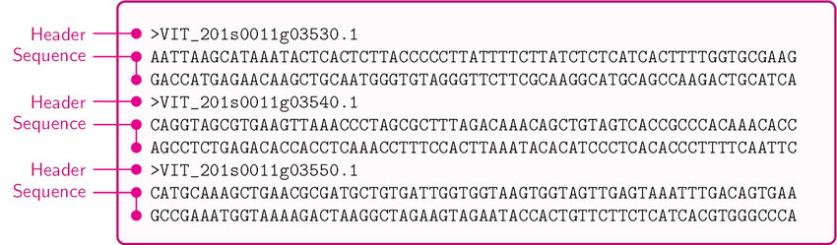
How does –omics Data look like?
Genomic / Transcriptomic
Sequences

Slide 11
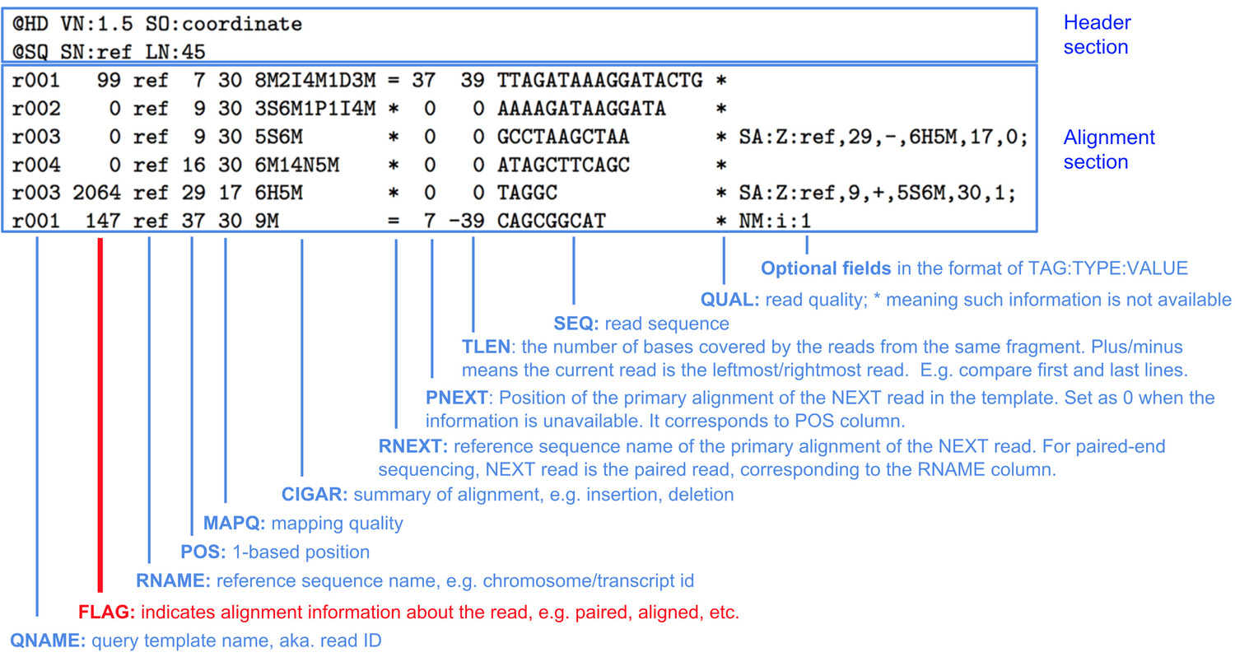
How does –omics Data look like?
Sequence
Alignment
Map
(.sam)

Slide 12

How does –omics Data look like?

Slide 13
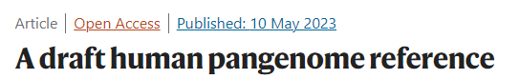
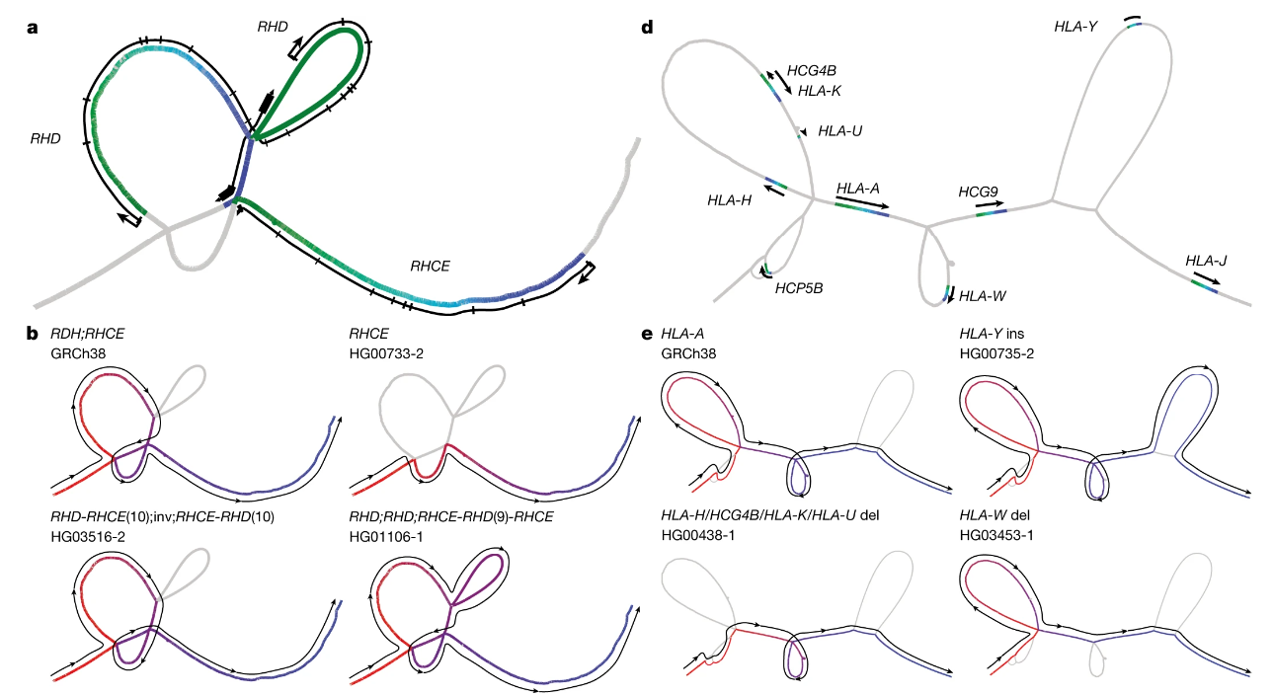
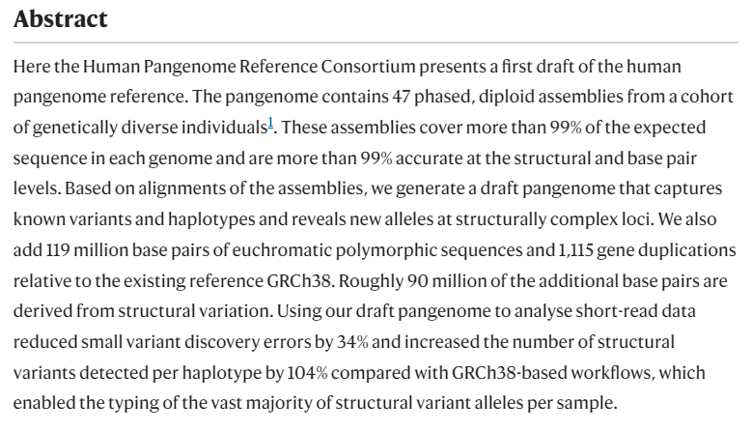
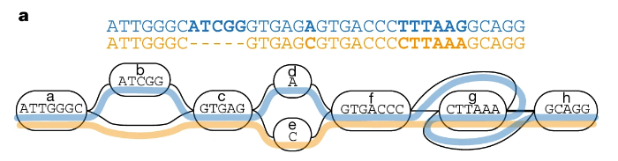
https://www.nature.com/articles/s41586-023-05896-x

